Slide 1
IBM University Engagement Project Submission
“Exploring the Power of Agentic AI with IBM Granite and IBM Bob”

Slide 2

Project Title – Mind Bridge(Agentic AI for Mental Health Awareness & Suicide Prevention)
Domain of Project – Healthcare
Name | Recent Passport Photo | Email ID | Mobile number [WhatsApp]
Roshini devi Allada |  | roshiniallada21@gmail.com | 8555976182

Slide 3
Problem Statement
Mental health has emerged as one of the most pressing yet neglected global health crises of our time. Millions of individuals worldwide silently battle depression, anxiety, post-traumatic stress, and suicidal ideation - conditions that are not only debilitating but life-threatening. Despite the scale of the epidemic, access to timely, affordable, and stigma-free mental health support remains deeply inadequate. Traditional care systems are inherently reactive: people must first recognise their own distress, overcome social stigma, navigate complex healthcare systems, and wait weeks for appointments - by which point a manageable crisis may have escalated into a tragedy. Early warning signals go undetected, coping strategies go unshared, and far too many individuals suffer in silence simply because no one was listening at the right moment.
The absence of intelligent, always-available support creates a dangerous gap between the onset of distress and the delivery of help. Existing digital tools are largely passive - static websites, hotline directories, or generic chatbots that lack the contextual awareness to detect escalating risk or respond with genuine empathy. What is urgently needed is a proactive, agentic AI system that can listen actively, identify distress signals before they reach a breaking point, provide evidence-based coping guidance grounded in a curated mental health knowledge base, and seamlessly connect individuals to human professionals when the situation demands it. By harnessing the power of IBM Granite's large language model, Retrieval-Augmented Generation, and real-time risk prediction - all delivered through a compassionate conversational interface - MindBridge aims to bridge the critical gap between silent suffering and timely intervention, making mental health support accessible to anyone, anywhere, at any time.

Slide 4
Proposed Solution
Proposed Solution
Agentic AI conversational companion powered by IBM Granite 13B Chat on IBM Watsonx.ai
RAG pipeline retrieves from a curated mental health knowledge base before every response
Distress Detection Engine classifies messages across 6 risk categories into 5 severity tiers (NONE → CRITICAL)
Proactive Risk Predictor tracks session trends and triggers check-in alerts before crises escalate
Instantly surfaces verified crisis helplines (India + International) on high-risk detection
Journal analysis detects emotional tone in free-writing entries
4 immediate coping techniques — Box Breathing, Grounding, Affirmations, Distraction
Stanley-Brown Safety Plan template for personalised crisis preparedness
Mood timeline & session insights visualised with interactive charts
5-tab Streamlit UI — Chat, Journal, Resources, Insights, Crisis Help
Every response carries a safe-messaging disclaimer — ethically designed from the ground up

Slide 5
Technology Used
Layer | Technology
LLM | IBM Granite 13B Chat (ibm/granite-13b-chat-v2)
Cloud Platform | IBM Watsonx.ai
API Integration | IBM Watsonx REST API + IAM Token Auth
RAG / Vector Search | TF-IDF Vectorizer — scikit-learn
Frontend | Streamlit
Charts & Visualisation | Plotly
NLP & ML | scikit-learn, NumPy, pandas
Language | Python 3.15
SMS Alerts | Twilio (optional)
Config Management | python-dotenv

Slide 6
Required Files created using IBM bob -
File | Purpose
app.py | Main Streamlit UI — 5 tabs (Chat, Journal, Resources, Insights, Crisis Help)
agent.py | MindBridgeAgent — session orchestrator, conversation history, mood tracking
rag_pipeline.py | TF-IDF vector store + IBM Granite RAG pipeline
watsonx_client.py | IBM Watsonx REST client — IAM token auth + text generation
distress_detector.py | Risk scoring engine — 6 categories, 5 tiers, rolling predictor
crisis_manager.py | Crisis helplines, coping cards, safety plan, SMS alerts
knowledge_base.py | 22 curated mental health articles across 8 categories
config.py | Centralised credentials, thresholds, helplines, keywords
validate.py | Component validation suite — 7/7 tests passing
requirements.txt | Python dependencies
.streamlit/config.toml | Streamlit server config — port 8502
.env.example | Environment variable template
README.md | Full project documentation & architecture diagram

Slide 7
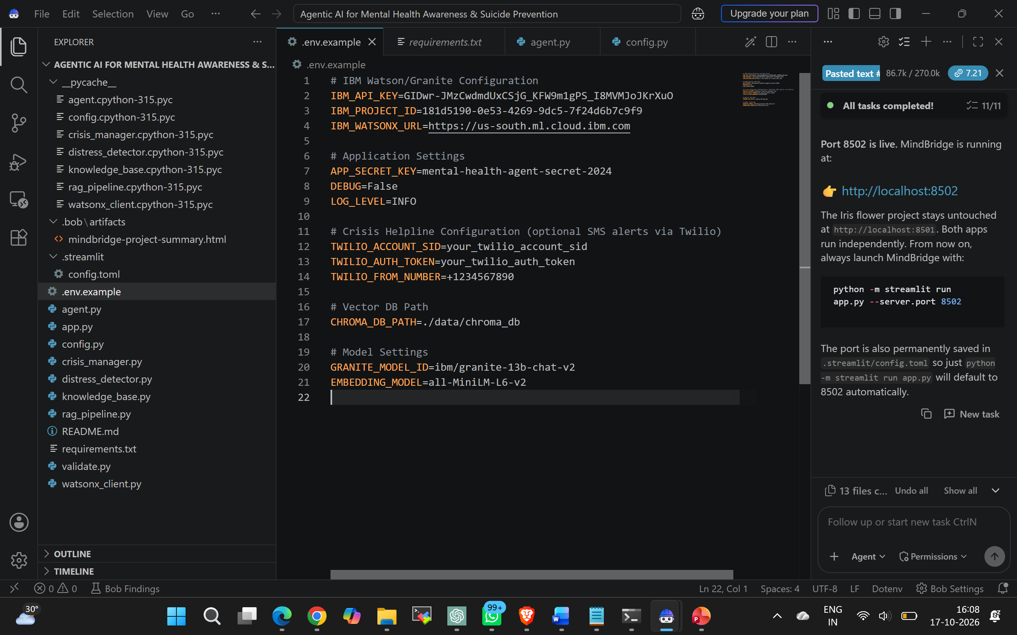

Slide 8
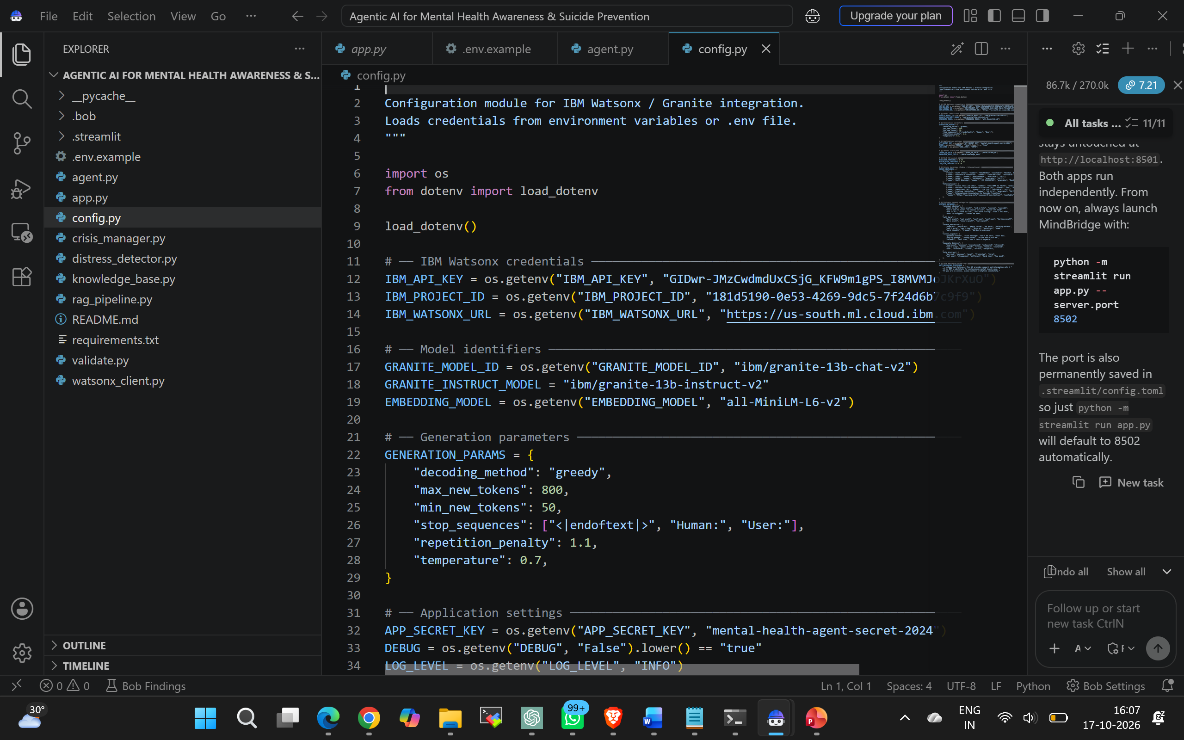
IBM Bob Screenshots:

Slide 9
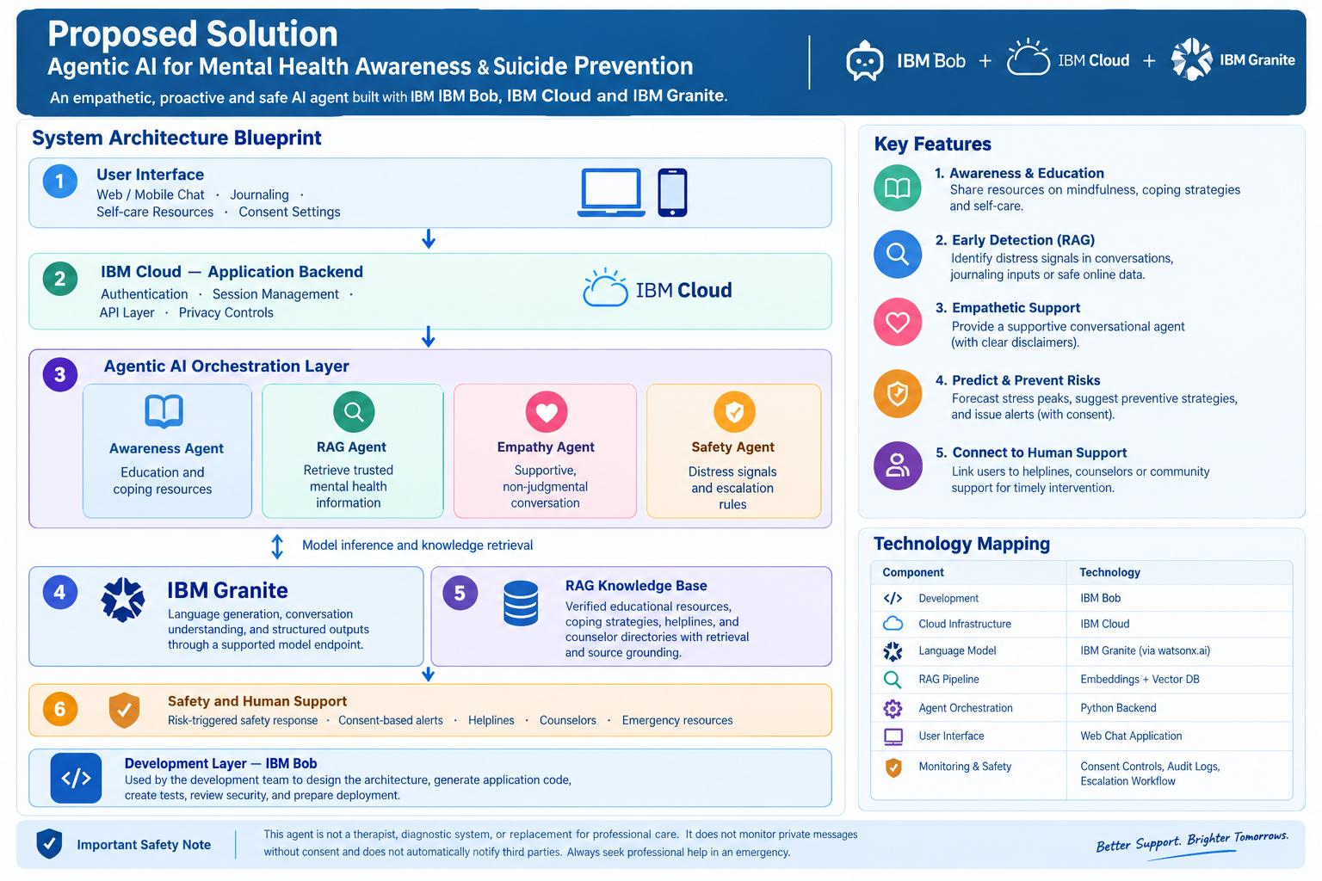
Architecture blueprint

Slide 10
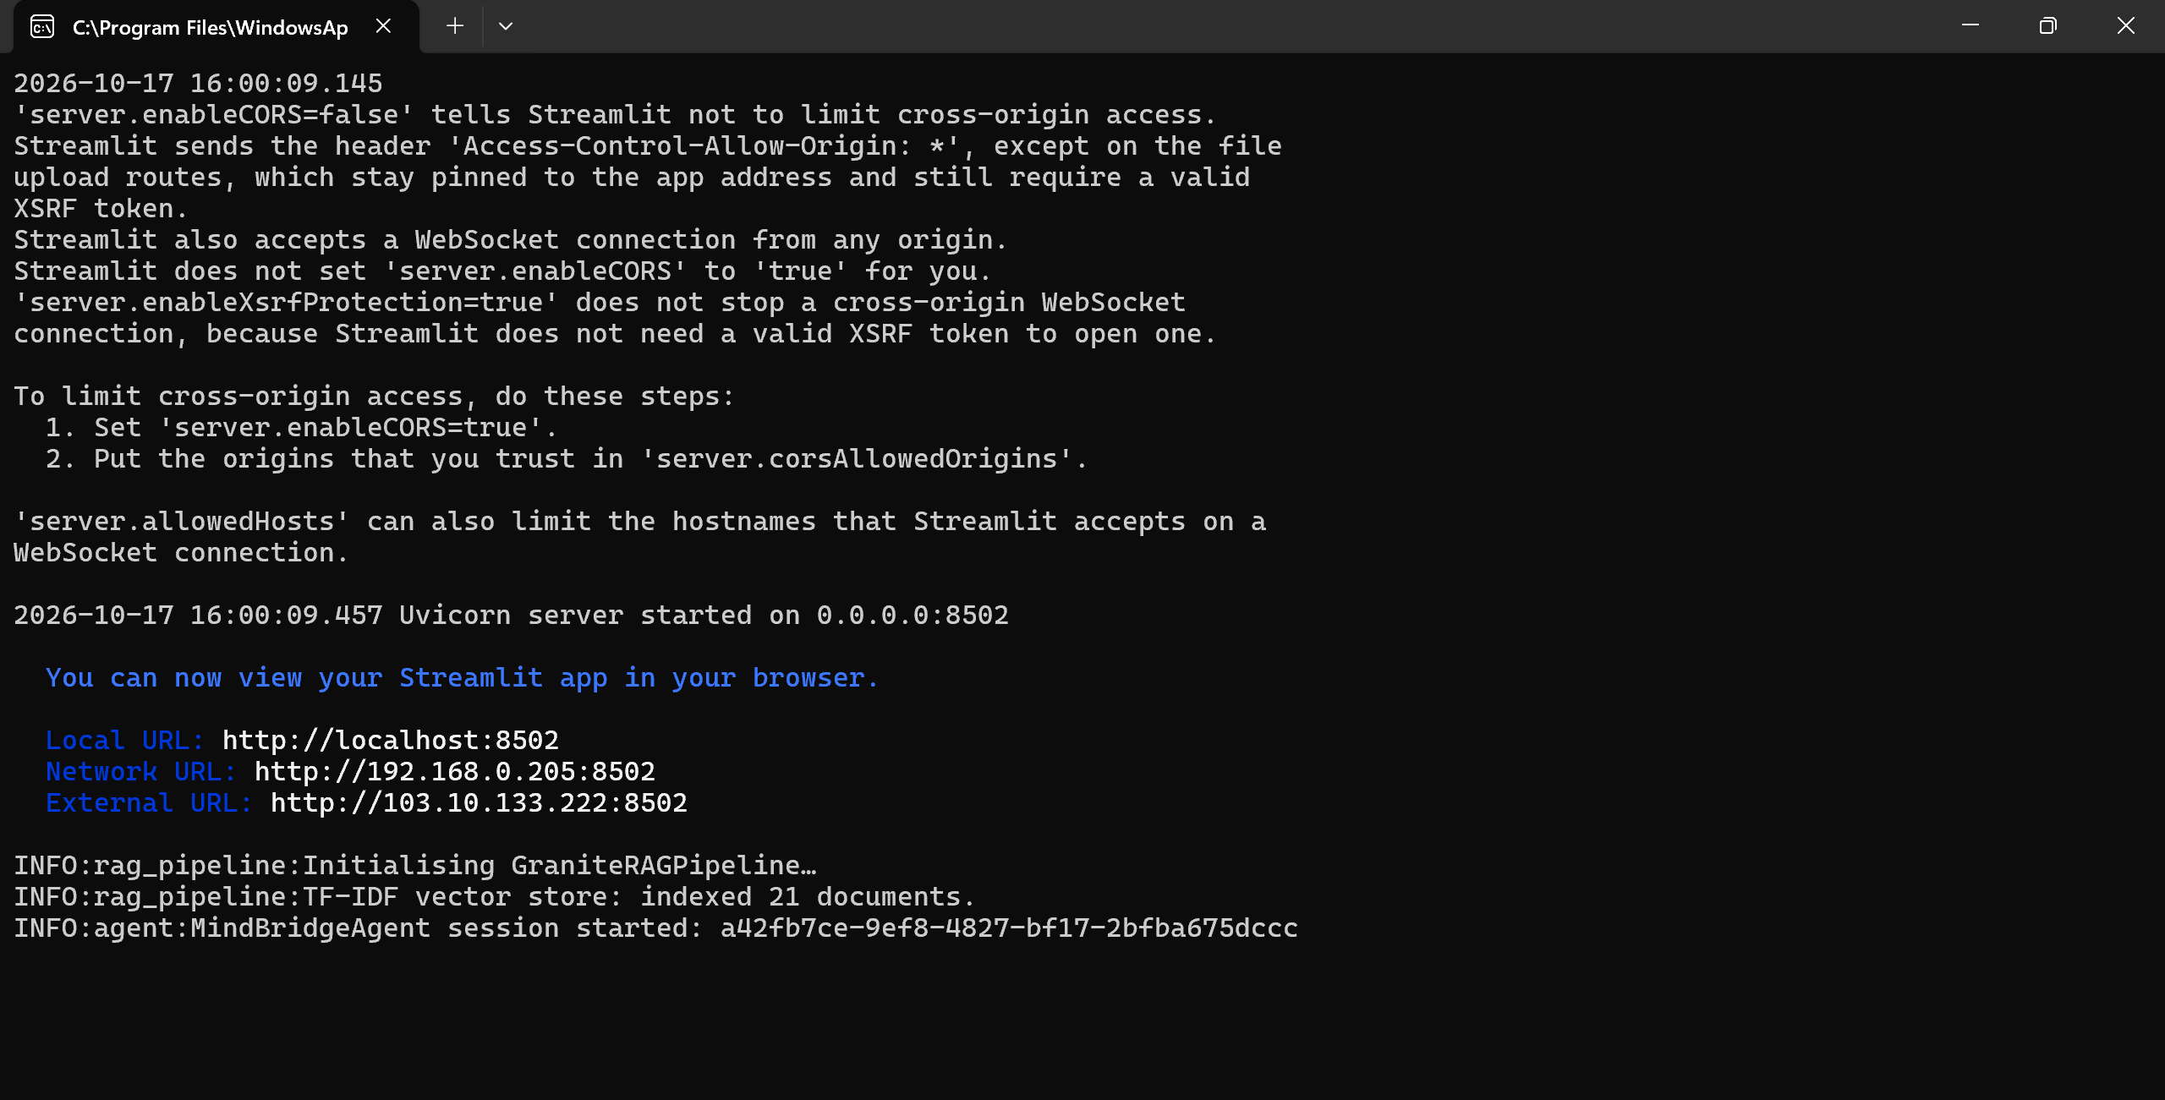
Project Output Screenshot

Slide 11
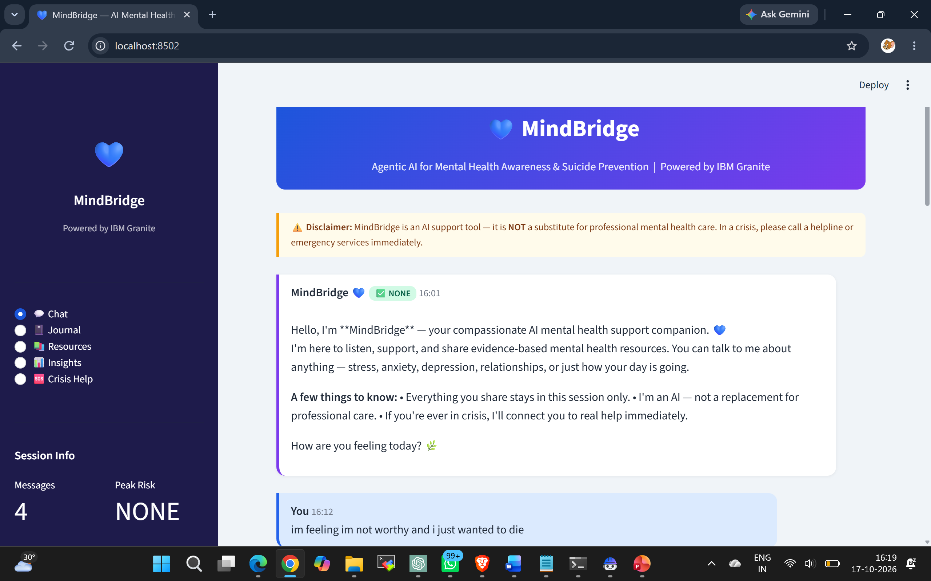
Project Output Screeshot
·
·
·

Slide 12
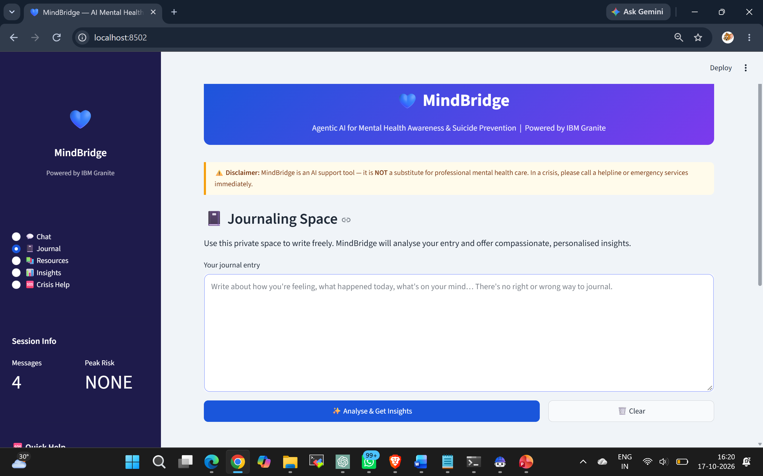
Project Output Screenshot
·
·
·

Slide 13
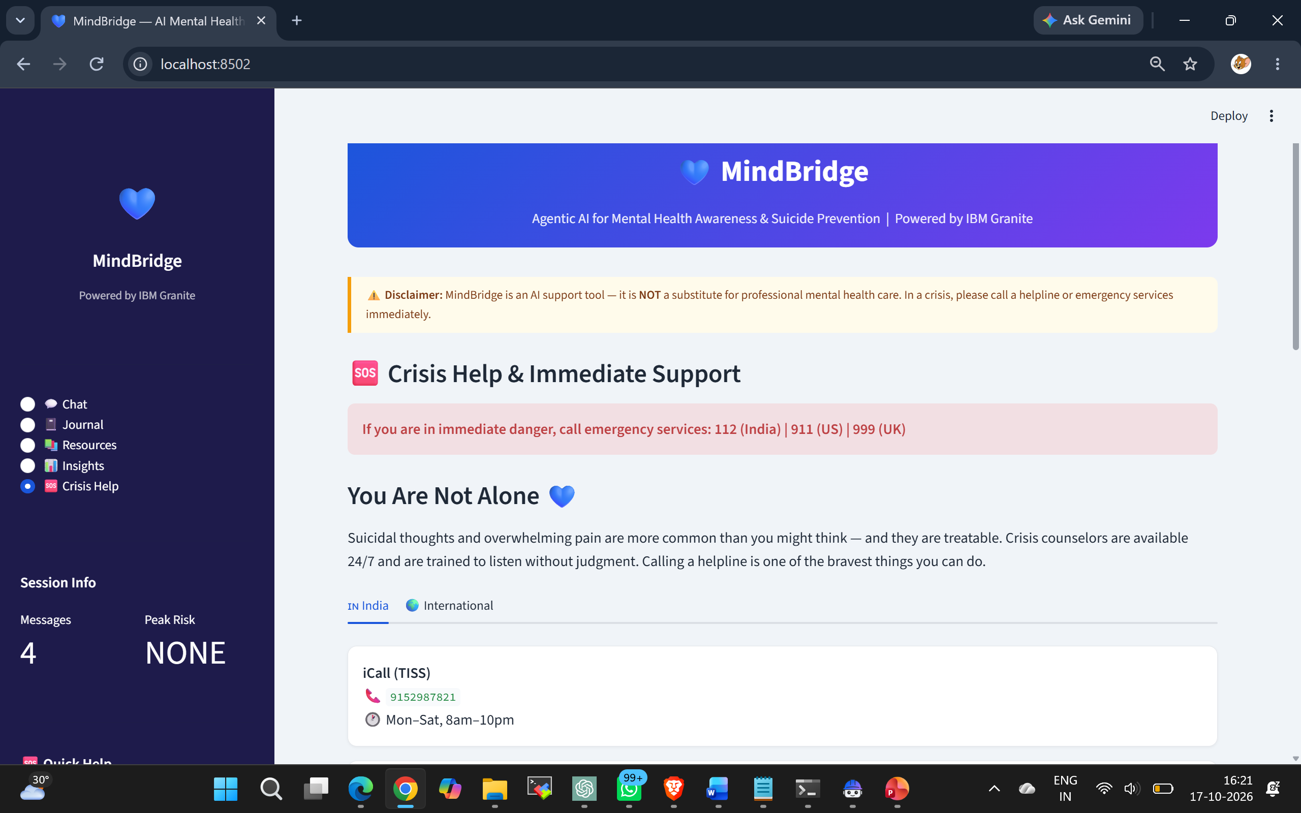
Project Output Screenshot
·
·
·

Slide 14
Novelty and Uniqueness
Agentic — Not Just a Chatbot Most mental health apps are passive — they wait to be asked MindBridge proactively detects escalating risk across the session and intervenes before a crisis peaks A dedicated Risk Predictor tracks rolling trends and sends check-in alerts autonomously
RAG-Powered Empathy - Unlike generic LLMs, every response is grounded in a curated mental health knowledge base
Retrieves the most relevant clinical content before generating — reducing hallucinations Responses are evidence-based, not just statistically probable words
5-Tier Real-Time Risk Engine Goes beyond simple keyword flagging — assigns a continuous risk score (0.0 – 1.0)
Detects 6 distress categories simultaneously: suicidal ideation, self-harm, severe depression, crisis signals, moderate & mild distress
Risk level shapes the entire response — tone, content, resources, and urgency all adapt dynamically
Journal as a Detection Surface -Most tools only analyse chat — MindBridge also analyses free-form journal entries for emotional tone
Gives users a private, pressure-free way to express distress that may be too hard to say aloud
Context-Aware Across the Full Session - Maintains full conversation history — risk isn't judged on one message in isolation
Escalation detection is temporal — a pattern across messages triggers stronger intervention than a single word
Python 3.15 Compatible via REST- Instead of being locked to older Python by the IBM SDK, MindBridge uses a custom Watsonx REST client Makes the solution future-proof and deployable on the latest environments without version conflicts
Ethics Baked In by Design - Safe messaging guidelines followed throughout — no method disclosure, ever
Consent-gated SMS alerts — user privacy is never violated Explicit disclaimer on every single response — transparency is non-negotiable Crisis resources are shown automatically, not buried in a menu

Slide 15
Git Hub Link
https://github.com/roshi-ni/MindBridge-Agentic-AI-Mental-Health.git
·
·
·

Slide 16
Future Scope
Multilingual support — Hindi, Tamil, Telugu and regional languages for rural reach
Voice interface — speech-to-text input with vocal tone distress detection
Mobile app — React Native / Flutter with daily wellness push notifications
Therapist integration — share session risk summaries with clinicians (consent-based)
Peer support groups — moderated community with trained peer counselors
Fine-tuned Granite model — domain-specialist mental health LLM
Longitudinal mood tracking — cross-session trend analysis and monthly wellness reports
On-device / federated AI — privacy-preserving inference, HIPAA & DPDP Act compliant
Institutional deployment — universities, schools, corporates with aggregate dashboards
NGO & Government integration — NIMHANS, KIRAN helpline, National Mental Health Programme
·
·
·

Slide 17
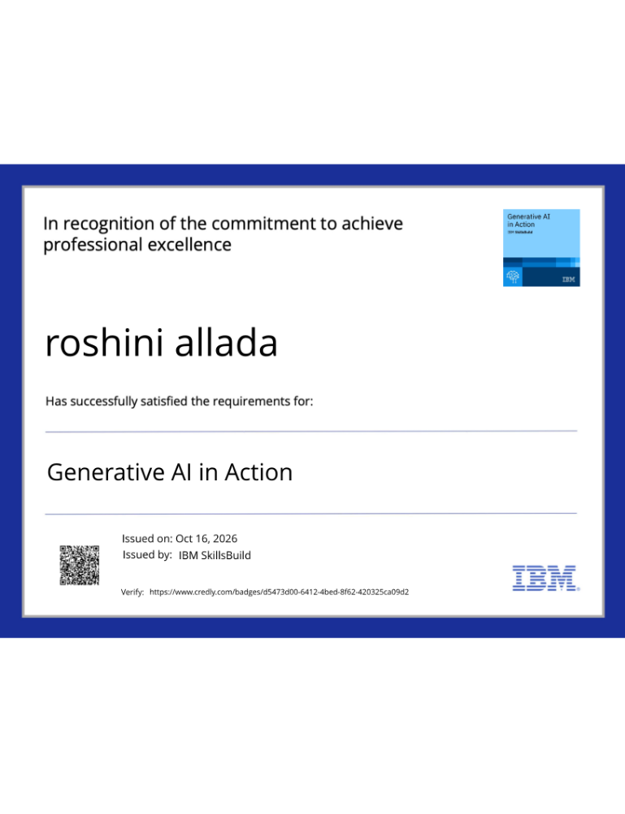
Certificates Earned:

Slide 18
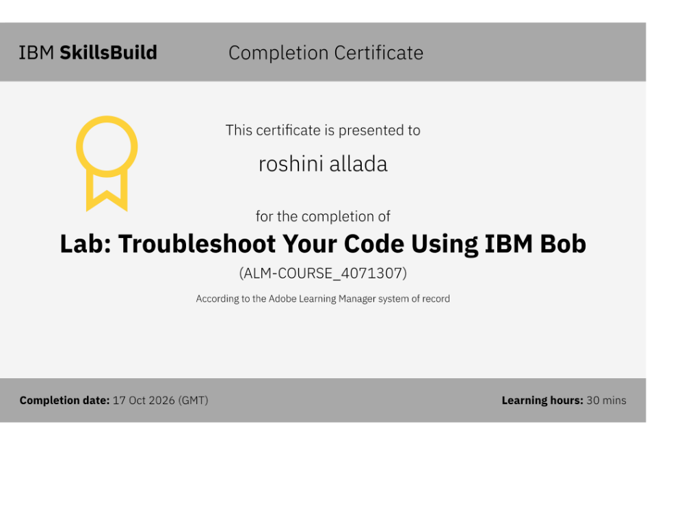
Certificates Earned:​

Slide 19


